Slide 1
NONPARAMETRIC STATISTICS FOR BEHAVIORAL SCIENCE
Multiple independent samples

Slide 2
The Kruskal-Wallis one-way analysis of variance by ranks (Kruskal-Wallis) is a test
that compares the medians of three or more samples on one dependent variable.
This test is the nonparametric counterpart of the parametric one-way analysis of
variance (ANOVA) that measures differences in the means of three or more samples.
The Kruskal-Wallis test may be thought of as an extension of the Wilcoxon Mann-
Whitney U test for measuring differences between two independent groups.
Data may be ordinal, ratio, or interval.
The Kruskal-Wallis test may be used when the data are not normally distributed and
meeting other ANOVA assumptions is questionable. However, Kruskal-Wallis is almost
as effective as the ANOVA procedure when the assumptions of normality and equal
variances are met.
Although the distributions from which the samples are taken do not need to be
normally distributed, the shapes of the distributions should be similar, with a difference
only in the medians. In other words, samples may have a positive or negative skew, yet
have different medians.

Slide 3
Subjects should be selected randomly and each subject should be independent of
all others. Likewise, groups should be independent of all other groups. The design
of the study should ensure independence of the error associated with the difference
between each value and the group median.
Sample sizes should be larger than five cases each, and unequal sample sizes are
acceptable.
The Kruskal-Wallis test assesses whether three or more samples come from the
same distribution. Differences in the ranks of observations are assessed by
combining observations for all groups and assigning ranks from 1 to N to each
observation, where N is the total number of observations in the combined array of
scores.

Slide 4

The lowest value is assigned a rank of 1 and the highest value is assigned a rank
corresponding to the total number of values in the combined groups.
Tied values are assigned the average of the tied ranks.
Ranks in each group are summed; and the sums of the ranks are tested for their
differences.
A single value is created from the combined differences in the sums of the ranks.
The formula with explanations for computing the Kruskal-Wallis H statistic is
given in Figure1.
Formula for Kruskal-Wallis H test. H = Kruskal-Wallis statistic, N = total number
of subjects, R₁ to Ri = rankings for Group 1 to last group (i), and n to n = number of subjects
for Group 1 to last group (i).

Slide 5
The null hypothesis is stated as: H₀: The population medians are equal.
The alternative hypothesis is stated as:
H_{A}: At least one of the group medians is different from the other groups.
The degrees of freedom, df, for the Kruskal–Wallis H-test are determined by
using formula: df = k−1
where df is the degrees of freedom and k is the number of groups.
Once the test statistic H is computed, it can be compared with a table of critical
values to examine the groups for significant differences.

Slide 6

If ranking of values results in any ties, a tie correction is required. In that case,
find a new H statistic by dividing the original H statistic by the tie correction. Use
formula below to determine the tie correction value;
where C_{H} is the ties correction, T is the number of values from a set of ties, and N
is the number of values from all combined samples.
If the H statistic is not significant, then no differences exist between any of the
samples. However, if the H statistic is significant, then a difference exists between
at least two of the samples.

Slide 7
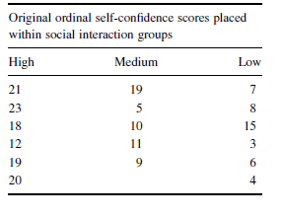
Example. Researchers were interested in studying the social interaction of
different adults. They sought to determine if social interaction can be tied to self-
confidence. The researchers classified 17 participants into three groups based on
the social interaction exhibited. The participant groups were labeled as follows:
High = constant interaction; talks with many different people; initiates discussion
Medium = interacts with a variety of people; some periods of isolation; tends to focus on fewer people
Low = remains mostly isolated from others; speaks if spoken to, but leaves interaction quickly
After the participants had been classified into the three social interaction groups,
they were directed to complete a self-assessment of self-confidence on a 25-point
scale. Table 1 shows the scores obtained by each of the participants, with 25 points
being an indication of high self-confidence.

Slide 8
The original survey scores obtained were converted to an ordinal scale prior to the data
analysis. Table 1 shows the ordinal values placed in the social interaction groups.
We want to determine if there is a difference between any of the three groups in Table 1.
Since the data belong to an ordinal scale and the sample sizes are small (n < 20), we will
use a nonparametric test. The Kruskal–Wallis H-test is a good choice to analyze the
data and test the hypothesis.
State the Null and Research Hypotheses
The null hypothesis states that there is no tendency for self-confidence to rank
systematically higher or lower for any of the levels of social interaction. The research
hypothesis states that there is a tendency for self-confidence to rank systematically
higher or lower for at least one level of social interaction than at least one of the other
levels.
We generally use the concept of “systematic differences” in the hypotheses.
The null hypothesis is
H_{O}: θ_{L} = θ_{M} = θ_{H}
The research hypothesis is
H_{A}: There is a tendency for self-confidence to rank systematically higher or lower for at least one level of social interaction when compared with the other levels.

Slide 9
Set the Level of Risk (or the Level of Significance) Associated with the Null
Hypothesis
The level of risk, also called an alpha (α), is frequently set at 0.05. We will use α =
0.05 in our example. In other words, there is a 95% chance that any observed
statistical difference will be real and not due to chance.
Choose the Appropriate Test Statistic
The data are obtained from three independent, or unrelated, samples of adults
who are being assigned to three different social interaction groups by observation.
They are then being assessed using a self-confidence scale with a total of 25 points.
The three samples are small with some violations of our assumptions of normality.
Since we are comparing three independent samples, we will use the Kruskal–
Wallis H-test.

Slide 10
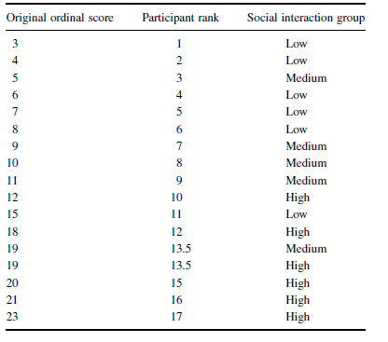
Compute the Test Statistic
First, combine and rank the three samples together.
Place the participant ranks in their social interaction groups to compute the sum of
ranks R_{i} for each group.

Slide 11
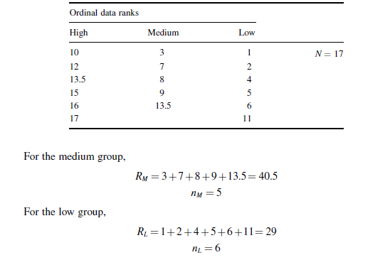
Compute the Test Statistic
Next, compute the sum of ranks for each social interaction group. The ranks in
each group are added to obtain a total R-value for the group.
For the high group,
R_{H} =10+12+13.5+15+16+17=83.5
n_{H} =6

Slide 12
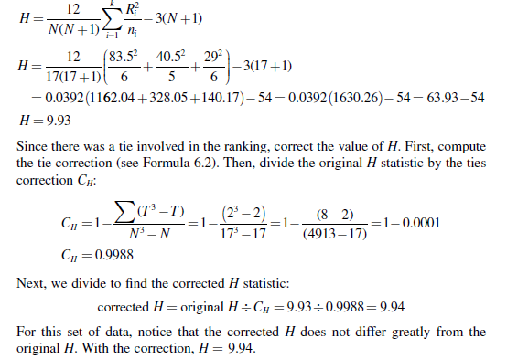
These R-values are used to compute the Kruskal–Wallis H-test statistic. The
number of participants in each group is identified by a lowercase n. The total group
size in the study is identified by the uppercase N.

Slide 13
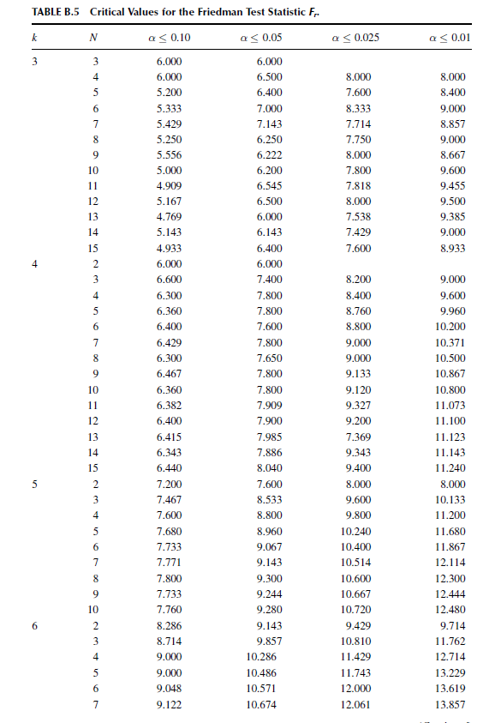

Slide 14
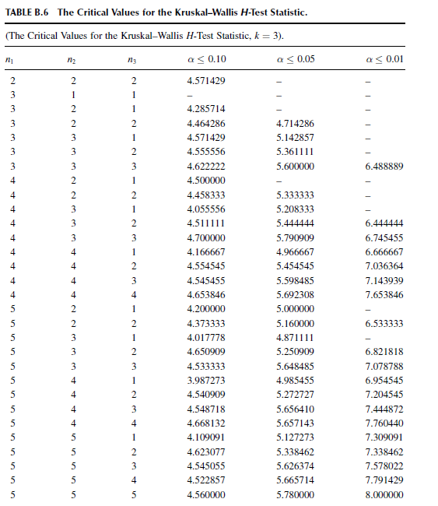

Slide 15
Determine the Value Needed for Rejection of the Null Hypothesis.
Using the Appropriate Table of Critical Values for the Particular
Statistic
We will use the critical value table for the Kruskal–Wallis H-test since it includes
the number of groups, k, and the numbers of samples, n, for our data. In this case,
we look for the critical value for k = 3 and n1 = 6, n2 = 6, and n3 = 5 with α = 0.05.
Using the tables the critical value for the Kruskal–Wallis H-test is 5.76.
Compare the Obtained Value with the Critical Value
The critical value for rejecting the null hypothesis is 5.76 and the obtained value is
H = 9.94. If the critical value is less than or equal to the obtained value, we must
reject the null hypothesis. If instead, the critical value exceeds the obtained value,
we do not reject the null hypothesis. Since critical value is less than the obtained
value, we must reject the null hypothesis.

Slide 16
At this point, it is worth mentioning that larger samples often result in more ties.
While comparatively small, as observed in step 4, corrections for ties can make a
difference in the decision regarding the null hypothesis. If the H were near the
critical value of 5.99 for df = 2 (e.g., H = 5.80), and the tie correction calculated
to be 0.965, the decision would be to reject the null hypothesis with the correction
(H = 6.01), but to not reject the null hypothesis without the correction. Therefore,
it is important to perform tie corrections.
Interpret the Results
We rejected the null hypothesis, suggesting that a real difference in self-confidence
exists between one or more of the three social interaction types. In particular, the
data show that those who were classified as fitting the definition of the “low” group
were mostly people who reported poor self confidence, and those who were in the
“high” group were mostly people who reported good self-confidence.
However, describing specific differences in this manner is speculative. Therefore,
we need a technique for statistically identifying difference between groups, or
contrasts.

Slide 17
Sample Contrasts, or Post Hoc Tests
The Kruskal–Wallis H-test identifies if a statistical difference exists; however, it
does not identify how many differences exist and which samples are different. To
identify which samples are different and which are not, we can use a procedure
called contrasts or post hoc tests.

Slide 18
> d8<-read.table("ex81.txt", header=TRUE)
> d8
confid group
1 21 1
2 23 1
3 18 1
4 12 1
5 19 1
6 20 1
7 19 2
8 5 2
9 10 2
10 11 2
11 9 2
12 7 3
13 8 3
14 15 3
15 3 3
16 6 3
17 4 3
> kruskal.test(confid ~ group, data = d8)
Kruskal-Wallis rank sum test
data: confid by group
Kruskal-Wallis chi-squared = 9.9439, df = 2, p-value = 0.00693

Slide 19
> library(PMCMR)
> posthoc.kruskal.nemenyi.test (confid ~ group, method="Tukey", data=d8)
Pairwise comparisons using Tukey and Kramer (Nemenyi) test
with Tukey-Dist approximation for independent samples
data: confid by group
1 2
2 0.1380 -
3 0.0052 0.5338
P value adjustment method: none
Warning message:
In posthoc.kruskal.nemenyi.test.default(c(21L, 23L, 18L, 12L, 19L, :
Ties are present, p-values are not corrected.
We notice that the high–low group comparison is indeed significantly different.
The example compare unrelated samples so we will use the Mann–Whitney U-test.
It is important to note that performing several two-sample tests has a tendency
to inflate the type I error rate. In our example, we would compare three groups,
k = 3. At α = 0.05, the type I error rate would be 1 − (1 − 0.05)3 = 0.14.

Slide 20
Example2. Sample Kruskal–Wallis H-Test (Large Data Samples)
Researchers were interested in continuing their study of social interaction. In a
new study, they examined the self-confidence of teenagers with respect to social
interaction. Three levels of social interaction were based on the following
characteristics:
High = constant interaction; talks with many different people; initiates discussion
Medium = interacts with a variety of people; some periods of isolation; tends to focus on fewer people
Low = remains mostly isolated from others; speaks if spoken to, but leaves interaction quickly
The researchers assigned each participant into one of the three social interaction
groups. Researchers administered a self-assessment of self-confidence. The
assessment instrument measured self-confidence on a 50-point ordinal scale.
Table 2 shows the scores obtained by each of the participants, with 50 points
indicating high self-confidence.
We want to determine if there is a difference between any of the three groups
in Table 2. The Kruskal–Wallis H-test will be used to analyze the data.

Slide 21
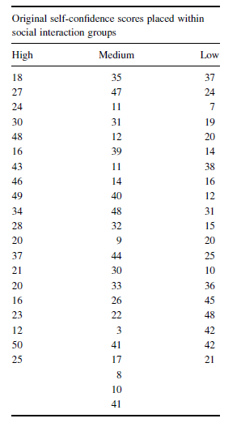
State the Null and Research Hypotheses
The null hypothesis states that there is no tendency
for teen self-confidence to rank systematically higher
or lower for any of the levels of social interaction.
The research hypothesis states that there is a
tendency for teen self-confidence to rank systematically
higher or lower for at least one level of social interaction
than at least one of the other levels. We generally use
the concept of “systematic differences” in the hypotheses.

Slide 22
The null hypothesis is: H_{O}: θ_{L} = θ_{M} = θ_{H}
The research hypothesis is
H_{A}: There is a tendency for teen self-confidence to rank systematically higher
or lower for at least one level of social interaction when compared with the other
levels.
Set the Level of Risk (or the Level of Significance) Associated with
the Null Hypothesis The level of risk, also called an alpha (α), is frequently set
at 0.05. We will use α = 0.05 in our example. In other words, there is a 95% chance
that any observed statistical difference will be real and not due to chance.
Compute the Test Statistic First, combine and rank the three samples together

Slide 23
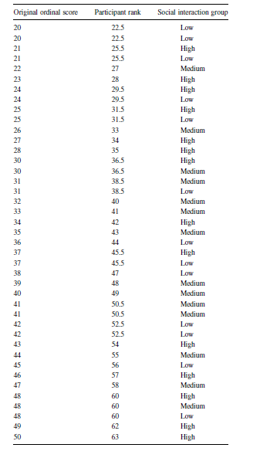
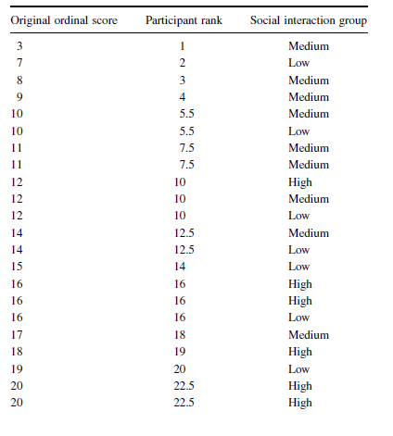
Original data:

Slide 24
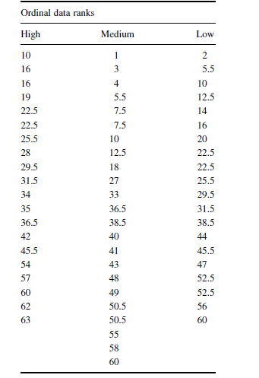
Place the participant ranks in their social interaction groups to compute the
sum of ranks, R_{i}, for each group.
Next, compute the sum of ranks for each social interaction group. The ranks
in each group are added to obtain a total R-value for the group.
For the high group, R_{H} = 709.5 and n_{H} = 20.
For the medium group, R_{M} = 699 and n_{M} = 23.
For the low group, R_{L} = 607.5 and n_{L} = 20.
These R-values are used to compute the Kruskal–Wallis
H-test statistic . The number of participants in each group
is identified by a lowercase n. The total group size in the
study is identified by the uppercase N.
In this study, N = 63.

Slide 25


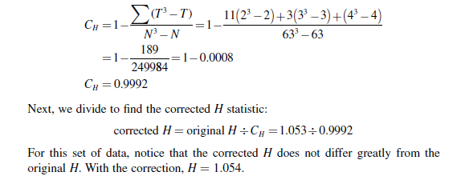
Using the formula
Since there were ties involved in the ranking, correct the value of H. First, compute
the tie correction. There were 11 sets of ties with two values, three sets of ties with
three values, and one set of ties with four values. Then, divide the original H
statistic by the tie correction C_{H}:

Slide 26
Determine the Value Needed for Rejection of the Null Hypothesis
Using the Appropriate Table of Critical Values for the Particular Statistic
Since the data have at least one large sample, we will use the χ2 distribution to
find the critical value for the Kruskal–Wallis H-test. In this case, we look for the
critical value for df = 2 and α = 0.05. Using the table, the critical value for
rejecting the null hypothesis is 5.99.
Compare the Obtained Value with the Critical Value
The critical value for rejecting the null hypothesis is 5.99 and the obtained value is
H = 1.054. If the critical value is less than or equal to the obtained value, we must
reject the null hypothesis. If instead, the critical value exceeds the obtained value,
we do not reject the null hypothesis. Since the critical value exceeds the obtained
value, we do not reject the null hypothesis.

Slide 27
Interpret the Results We did not reject the null hypothesis, suggesting that no
real difference exists between any of the three groups. In particular, the data
suggest that there is no difference in self-confidence between one or more of the
three social interaction types.
Reporting the Results The reporting of results for the Kruskal–Wallis H-test
should include such information as sample size for each of the groups, the H
statistic, degrees of freedom, and p-value’s relation to α. For this example, three
social interaction groups were compared. The three social interaction groups were
high (n_{H} = 23), and low (n_{L} = 20). The Kruskal–Wallis H-test was not significant
(H₍₂₎ = 1.054, p < 0.005 ).

Slide 28
> d8<-read.table("ex82.txt", header=TRUE)
> kruskal.test(Score ~ group, data = d8)
Kruskal-Wallis rank sum test
data: Score by group
Kruskal-Wallis chi-squared = 1.054, df = 2, p-value = 0.5904
> posthoc.kruskal.nemenyi.test (Score ~ group, method="Tukey", data=d8)
Pairwise comparisons using Tukey and Kramer (Nemenyi) test
with Tukey-Dist approximation for independent samples
data: Score by group
High Low
Low 0.65 -
Medium 0.64 1.00
P value adjustment method: none
Warning message:
In posthoc.kruskal.nemenyi.test.default(c(3L, 7L, 8L, 9L, 10L, 10L, :
Ties are present, p-values are not corrected.

Slide 29
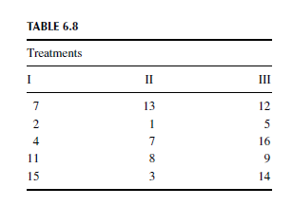
Practice 1. A researcher conducted a study with n = 15 participants to investigate
strength gains from exercise. The participants were divided into three groups and
given one of three treatments. Participants’ strength gains were measured and
ranked.
The rankings are presented in Table 6.8.
Use a Kruskal–Wallis H-test with α = 0.05 to determine if one or more of the
groups are significantly different

Slide 30
Practice 2. A British estate agency sells properties in villages A, B and C. The
homes for sale in these villages are at the following prices (£K):
A 139 145 171
B 151 163 188 197
C 199 250 360
Use the Kruskal-Wallis test to examine the validity of the hypothesis that the house
prices in these samples come from identical populations.

Slide 31

Practice 3. Uniform editions by each of three writers of detective fiction are
selected. The numbers of sentences per page, on randomly selected pages in a work
by each are
Use the Kruskal-Wallis test to examine the validity of the hypothesis that these
may be samples from identical populations.

Slide 32
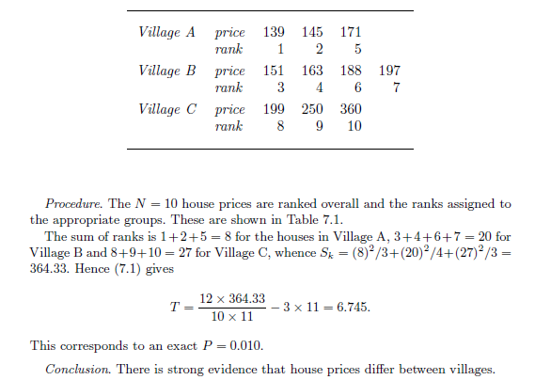
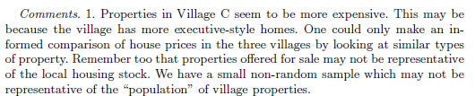

Slide 33
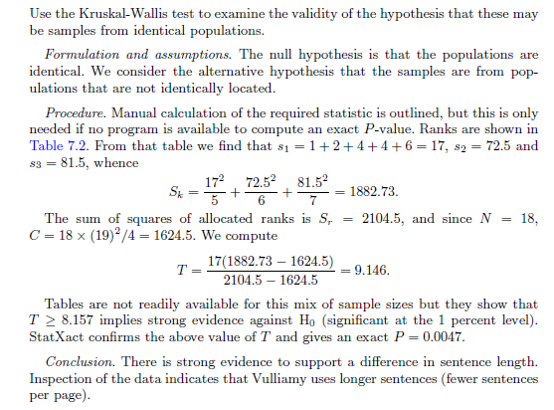
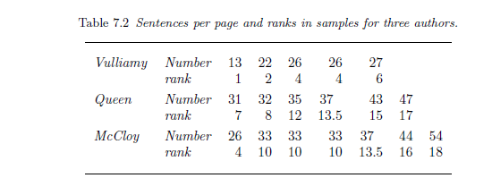

Slide 34
